Slide 1


MicroFlow AI
FinTechathon 2026 · International Track · Topic E: SME Finance Copilot
Mona’s customers owe her 2.6 million pounds.
On Sunday, she can’t make payroll.
Kareem Diaa Helal · Ahmed Mohamed · Mostafa Abdelhamed · ElSewedy University of Technology, Cairo
Notes:
Mona runs a bakery supply business in Cairo. Her customers owe her 2.6 million pounds. And on Sunday, she can’t pay her staff. That sounds like a contradiction, but for a lot of small businesses in Egypt it’s just a normal month. We’re team MicroFlow from ElSewedy University of Technology, and this is what we built for her.

Slide 2
Mona isn’t unusual. Most Egyptian firms fund themselves.
88%
4.8%
20%
of capital spending is self-financed. Banks fund 3%, against 15% across MENA.
of firms use a bank to finance working capital, the money that pays salaries.
CBE overnight lending rate. Even when credit exists, picking the wrong product hurts.
IFC puts the lending gap for Egypt’s small businesses at about USD 71 billion. Banks want to lend more; they just can’t read firms without audited accounts.
Sources: World Bank Enterprise Survey 2025/26 via EnterpriseAM (Jun 2026) · World Bank Enterprise Survey 2020 · CBE MPC, rate held 24 Sep 2026 · IFC press release, Dec 2023
Notes:
Mona isn’t an edge case. The latest World Bank Enterprise Survey found Egyptian companies finance 88 percent of their capital spending themselves; banks cover just 3 percent, compared with 15 percent across the region. Only 4.8 percent of firms use a bank for working capital, which is the money that pays salaries and suppliers. And credit isn’t cheap: the central bank’s overnight lending rate is 20 percent. The IFC estimates the lending gap for Egypt’s small businesses at around 71 billion dollars. The banks aren’t the villain here. They simply can’t assess a business that doesn’t have audited accounts.

Slide 3
Mona’s week
Monday 19 Oct
Mon & Thu
Sunday 25 Oct
Meanwhile
EGP 337k
~EGP 100k
EGP 248k
EGP 2.63M
in the bank. Looks fine.
to the flour mill, twice a week.
payroll for 22 people.
owed by 7 customers, arriving whenever they choose.
She finds out on Sunday. Then she calls a cousin, delays a supplier, or takes the first loan anyone offers.
Al-Nour Bakery Supplies is a synthetic demo business: 6 months of statements, 94 e-invoices, built from realistic patterns.
Notes:
Here’s Mona’s week. Monday she has 337 thousand in the bank, which looks fine. But twice a week about 100 thousand goes to the flour mill, and on Sunday payroll for 22 people is due: 248 thousand. Meanwhile 2.6 million is owed to her by seven customers, and they’ll pay when they pay. Today, she finds out on Sunday. Then she borrows from family, delays a supplier, or takes whatever loan she can get, usually the expensive one. To be clear, Al-Nour is a synthetic business we built for the demo, built to mirror the patterns in the figures you just saw.

Slide 4







What MicroFlow does for her, and where it stops
Reads
Notices
Compares
Prepares
Waits
her statements and invoices, as they are
who will pay late and when cash runs short
every way to cover the gap, by real cost
the application, so she doesn’t fill forms
for her yes. Nothing leaves without it.
Notes:
So what does MicroFlow actually do? It reads her paperwork the way it already is. It notices which customers will pay late and when the money will run short. It compares every way to cover that gap by what it really costs. It prepares the application so she doesn’t spend an evening on forms. And then it waits. Nothing leaves the system until Mona says yes. That’s how we read the theme “AI as a financial participant”: it does real work, but she stays the one who decides.

Slide 5



She doesn’t have to change how she works
Bank statements
E-invoices
Informal notes
PDF or CSV. Every line auto-tagged: InstaPay inflows, payroll, rent, utilities, suppliers.
XML batches, JSON or PDF. Validated, de-duplicated, buyer ids pseudonymised.
Typed or chat-exported receipts in Arabic or English, for businesses without clean ledgers.
Notes:
We didn’t want Mona to learn new software or keep new books. MicroFlow works with what she already has. Bank statements as PDF or CSV, where every transaction is categorised automatically. E-invoices as XML, JSON or PDF, validated and de-duplicated. And because many micro businesses keep informal records, we also parse typed or chat-exported notes in Arabic or English. Every source file is fingerprinted with SHA-256, so any number in the credit dossier can be traced back to the document it came from.

Slide 6
First, it learns how each customer really pays
6.5 d
7.7 d
model error (MAE)
“buyer average” baseline
Learns from each buyer’s history with this business, sector, order size, terms and season. New buyers start from a sector prior.
What drives the prediction
Buyer history
51%
Trained on simulated B2B payment behaviour; retrains on real ledgers with the same features.
Buyer sector
31%
Order size vs usual
5%
Notes:
The first thing MicroFlow has to answer is simple to ask and hard to get right: when will each customer actually pay? We use an XGBoost regression model with features like the buyer’s past delays with this business, its sector, the order size relative to its usual order, the payment terms and the month. On held-out data the model’s average error is 6.5 days, versus 7.7 days for the obvious baseline of “assume this buyer’s historical average”. To be transparent: the training data is a simulation we built of B2B payment behaviour; with real ledgers it retrains on exactly the same features.

Slide 7
Then it explains her credit in plain words
Obligations paid on time
100
Buyer diversity
84
Inflow stability
62
57.9
Receivables quality (AI)
59
Net cash margin
41 · weak
out of 100 · grade C · advisor review required below 60
Digital (InstaPay) share
37 · weak
Cash buffer
17 · weakest
“Your balance covers 8 days of spending.” Every factor comes with a sentence like that.
Sub-scores 0–100. Receivables quality uses the XGBoost-predicted pay dates.
Notes:
Next, a credit score she can actually read. It’s built from how money moves through her account, not from audited accounts. We deliberately chose a transparent scorecard over a black box, because the owner, an advisor and a bank auditor all need to understand it. Al-Nour scores 57.9, grade C. The dossier shows why: obligations are paid like clockwork and buyers are diversified, but the cash buffer is only about 8 days and margins are thin. Because the score is under 60, the system flags it for an advisor; it never declines anyone automatically.

Slide 8
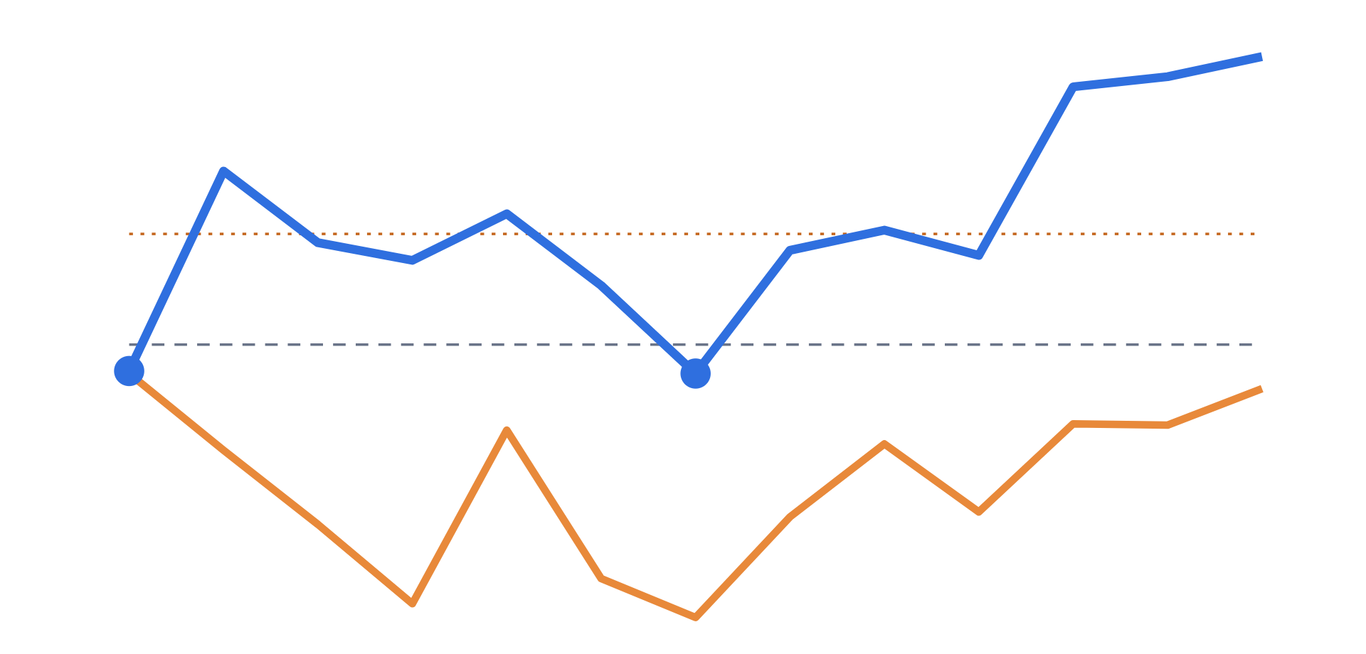
It sees the crunch before she feels it
Critical · week 1
Payroll lands before collections: −EGP 75k
Critical · week 7
Second dip: −EGP 80k
Warning · concentration
Nile View Hotel holds 39% of open receivables
Gap to close: EGP 392k
Blue: base case · Orange: stress (+21 days late, 85% collected) · dashed: zero · dotted: 7-day buffer (EGP 311k)
Notes:
Put the predicted pay dates together with her regular bills and MicroFlow forecasts cash for 13 weeks. The blue line is the base case. It dips below zero in week 1, because payroll lands before collections, and again in week 7. The orange line is the stress case: every customer 21 days later and 15 percent less collected. Alerts are raised automatically, including a concentration warning: one hotel holds 39 percent of what she is owed. The agent computes the gap to reach a 7-day cash buffer: about 392 thousand pounds.

Slide 9

It finds the cheapest fix, then asks her
Option (sandbox providers) | Raises (EGP) | Cost (EGP) | Per 1,000 | Verdict
Factor 4 invoices · NileFactor | 414,630 | 17,332 | 42 | Recommended
6-month loan · Cairo Micro Lending | 391,649 | 37,355 | 95 | Eligible, 2.2× cost
Invoice discounting · Delta | — | — | — | Not eligible: score below 60
Agent drafts
Owner approves
Provider OK · SBX-F4025422B7
Invoices locked
Notes:
Now it has to choose. It compares every product it is eligible for. Factoring four invoices with the sandbox NBFI raises 414 thousand for 17 thousand in fees. A six-month loan would cost 37 thousand, more than double. Invoice discounting is shown as not eligible, with the reason: the score is below 60. The agent drafts the factoring application. Mona reviews and approves it. The sandbox provider returns a decision and a reference. The financed invoices are then locked so they can never be pledged twice. All the providers here are simulated; no real money moves.

Slide 10






Her data stays hers
Security and compliance
12 / 12
attack tests passed
Envelope encryption
3 permission tiers
Hash-chained audit
AES-256-GCM, a fresh key per field, KMS-ready master key
Owner, advisor, auditor; strict tenant isolation
Every AI decision logged; any edit breaks the chain
Human in the loop
Hostile input
Strong auth
Agent drafts only; owner approves; no auto-decline
XXE blocked, size caps, file typing, validation
PBKDF2 passwords, short JWTs, lockout after 5 tries
Notes:
Security and compliance is 30 percent of the score, and it is the area our team specialises in. Every sensitive field is encrypted with AES-256-GCM envelope encryption: a fresh key per value, wrapped by a master key designed to live in a KMS. Three permission tiers with tenant isolation: the auditor can verify but never change, the advisor can analyse but never approve. Every AI decision is hashed into a tamper-evident audit chain; in our evidence we edit a credit score directly in the database and the chain catches it. The agent only drafts, the owner approves, and nobody is declined automatically. We ran 12 attack tests against the live API and all 12 passed; the known-risk list is in our self-assessment report.

Slide 11
What’s running today
Dashboard
Streamlit: ingestion, dossier, runway, agent, audit vault
API & security
FastAPI · JWT · role and tenant checks · hash-chained audit log
Copilot
13-week forecast · alerts · financing matcher · agent plan · EN/AR Q&A
AI engine
XGBoost delay model · explainable scorecard · policy checks
Data
PostgreSQL (encrypted fields) · Redis cache · Docker / Cloud Run
22 automated tests · 12 attack tests · one-command Docker stack · every API call logged
Notes:
Everything you’ve seen so far is running code. A Streamlit dashboard talks to a FastAPI backend that enforces authentication, roles and tenant isolation and writes the audit chain. Beneath it, the copilot layer does the forecasting, matching and agent planning, on top of the AI engine with the XGBoost model and the scorecard. Data sits in PostgreSQL with encrypted fields, and the whole stack starts with one Docker command. We ship 22 automated tests and a full log of every API call from our sandbox run.

Slide 12
Who this helps, and how it pays for itself
SME owners
Lenders & NBFIs
Next 6 months
See the crunch weeks ahead and pay less for the money that fixes it.
Receive pre-vetted, explainable, audit-ready applications from thin-file SMEs.
Pilot with 3+ Cairo SMEs · calibrate on real ledgers · first NBFI partner API
Why it matters: small businesses produce more than a third of Egypt’s GDP and employ almost 40% of its workers.
How it earns: free for the SME; the lender pays a referral fee on each funded application [fee % to confirm].
Source: IFC press release, 4 Nov 2025 (Suez Canal Bank partnership)
Notes:
Who does this help? SME owners see a cash crunch weeks ahead and pay less for the money that fixes it. Lenders and non-bank financiers get pre-vetted, explainable applications from businesses they could not assess before. Our plan for the next six months: pilot with Cairo SMEs, calibrate the model on real anonymised ledgers, and connect our first financing partner’s API. Why does it matter? According to the IFC, small businesses produce more than a third of Egypt’s GDP and employ almost 40 percent of its workers. And the business model is simple: free for the SME, with the lender paying a referral fee on each funded application, because we save them the cost of finding and assessing the borrower. [Team: replace the bracketed items with your real pilot target and fee assumption before recording.]

Slide 13


MicroFlow AI: cash on time, decisions in the owner’s hands
Kareem Diaa Helal
Ahmed Mohamed
Mostafa Abdelhamed
Cybersecurity · security design
Cloud · architecture & deployment
AI · models & analytics
Code, technical documentation, security report and sandbox logs: github.com/kareem-diaa/MicroFlow-AI
Notes:
To close: MicroFlow AI gets small businesses their cash on time, while every decision stays in the owner’s hands. We are Kareem, focused on security, Ahmed, on cloud and architecture, and Mostafa, on the AI. Our code, documentation, security report and full sandbox logs are in the repository. Thank you.

